Slide 1
DRAWING MACHINE LEARNING CLASSIFIER
PRESENTED BY 4 MASKATEERS
ALANNA JAVIER, ANAND SHARAN, DONNA TIGRETT, & ELIZABETH KOEHLER

Slide 2
PROJECT OBJECTIVE:
To classify user drawings using a CNN machine learning classification model to predict which class of image is closest to the input.

Slide 3










Project Workflow
Data Preparation
Machine Learning
Deployment

Slide 4
DATA PREPARATION STEPS

Slide 5

Data Source: Drawing classes in Numpy bitmap files
Bowtie
Butterfly
Cake
Cat
Dog
Dolphin
Dumbbell
Elephant
Fish
Helicopter
Leaf
Mountain
Octagon
Panda
Rainbow
Notes:
The quick draw data set have 345 categories of images, and we decided to train our own model on 15 classes of images.

Slide 6
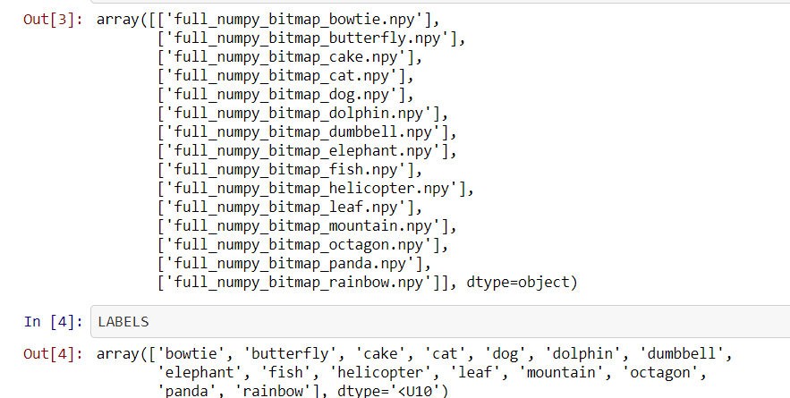

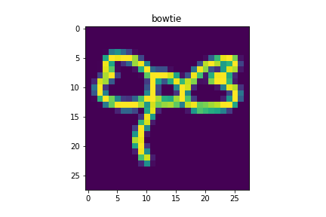
CREATE A PYTHON NUMPY ARRAY OF IMAGES
NUMPY Bitmap Files
Source Image
Numpy Bitmap Image

Slide 7
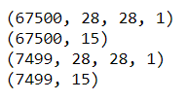
SPLIT THE IMAGES
INTO TRAINING AND TESTING
Train and Test image counts
90% of the images are used for training and 10% are used for testing
Dataset 75000 images
Train 67500 images
Test 7500 images

Slide 8
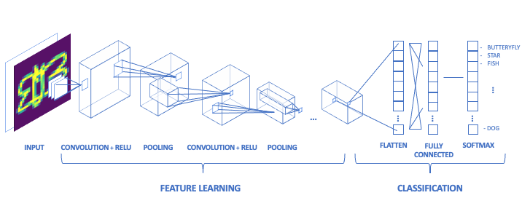
MODEL CREATION AND TRAINING
Convolutional Neural Network

Slide 9
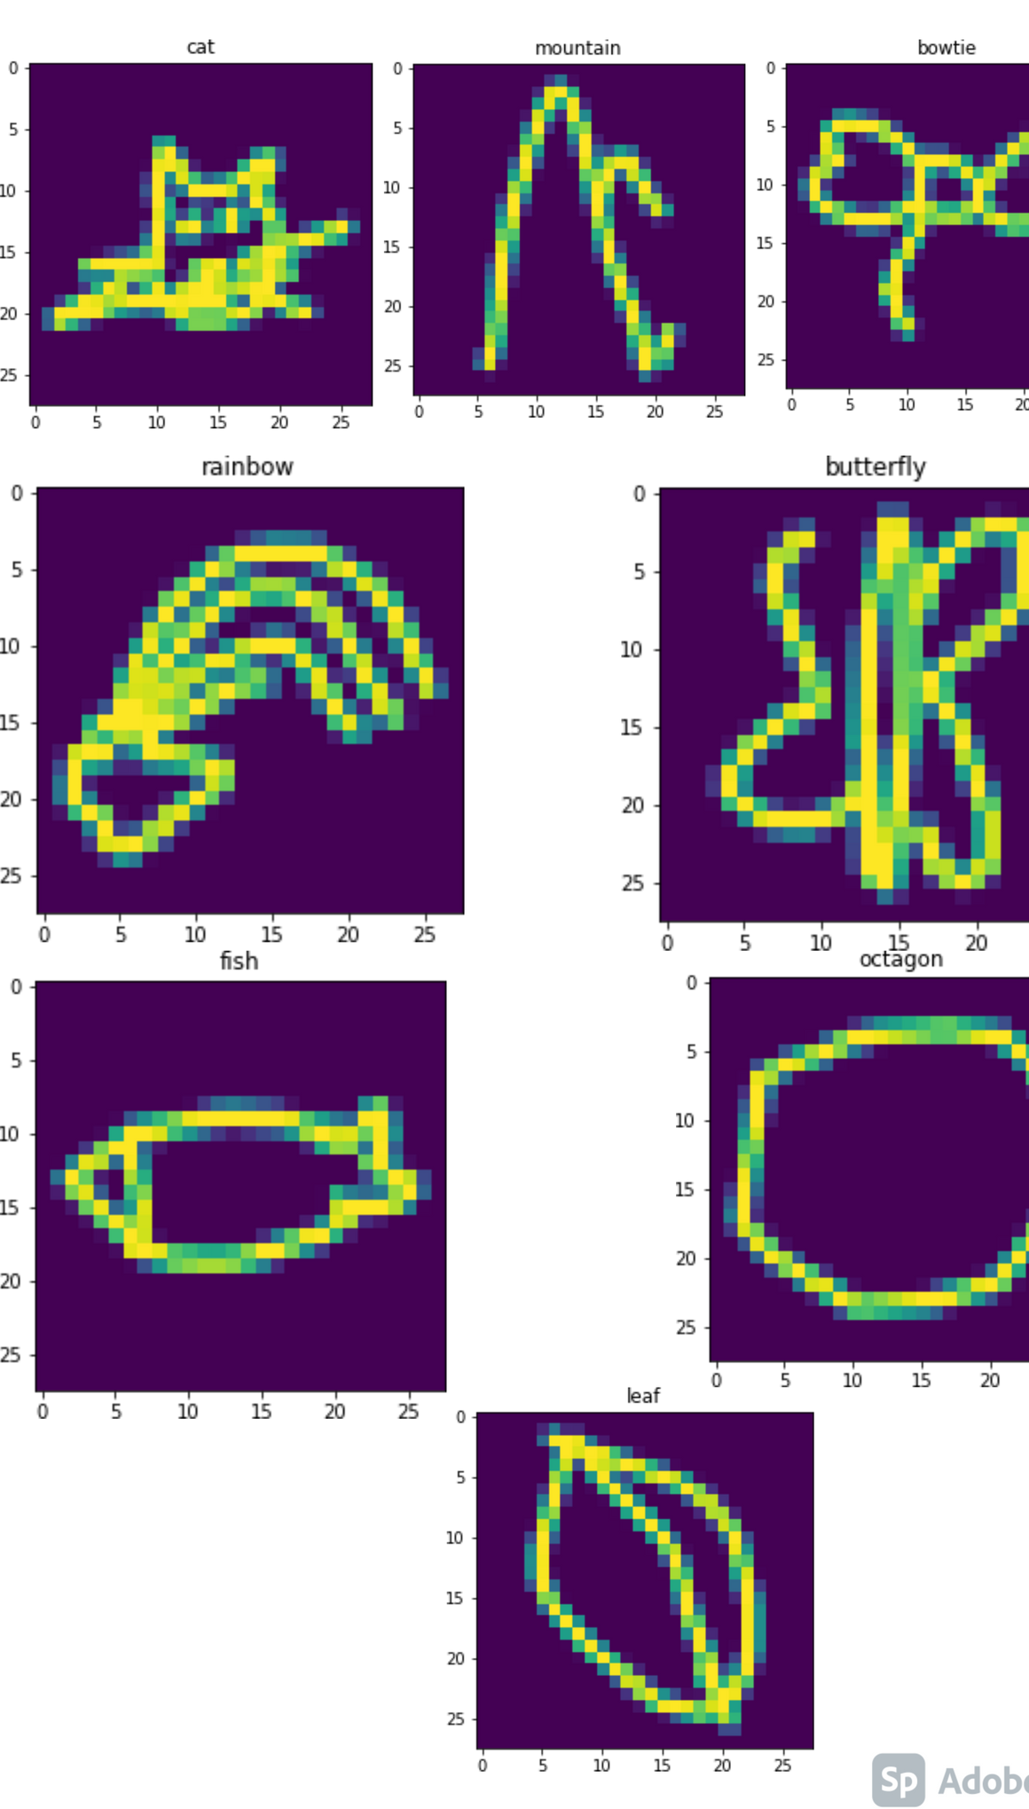
MODEL IMAGES
Sample Training input images
Cat
Mountain
Bowtie
Rainbow
Butterfly
Fish
Octagon
Leaf

Slide 10
MODEL COMPILATION
Compile parameters
Cross-entropy Loss function
Adam Optimizier

Slide 11
MODEL FITTING
Accuracy to over 97% on the training data by setting:
EPOCH parameter to 30
Model fitting output

Slide 12
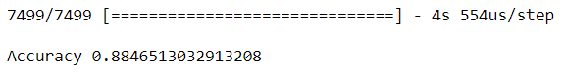
TEST MODEL
Accuracy to over 88% is observed on the test data of 7500 images
Model test output

Slide 13

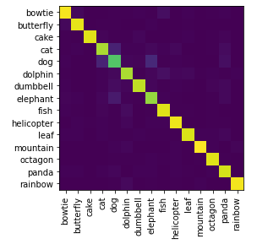
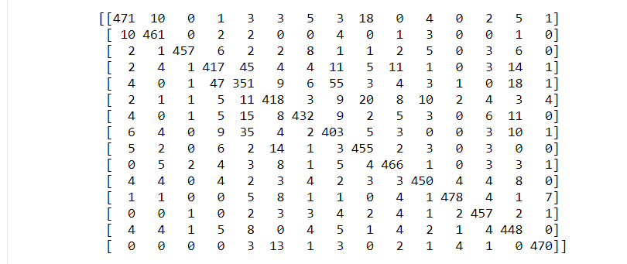
CNN MODEL
Confusion Matrix diagram
Confusion Matrix Values

Slide 14
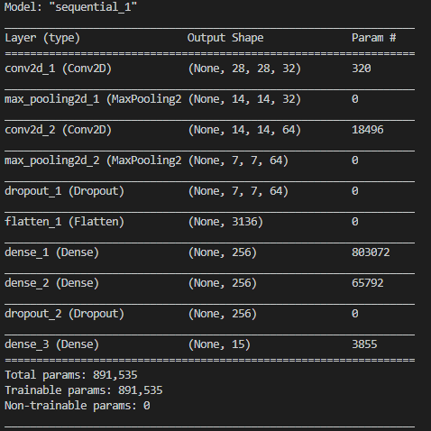
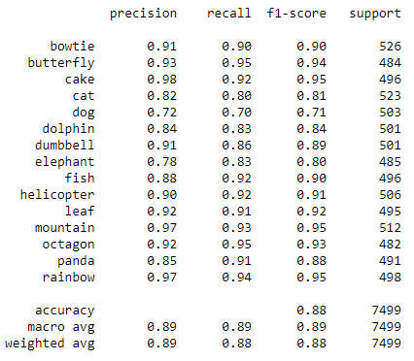
CNN MODEL LAYERS, PARAMETERS AND CLASSIFICATION REPORT

Slide 15

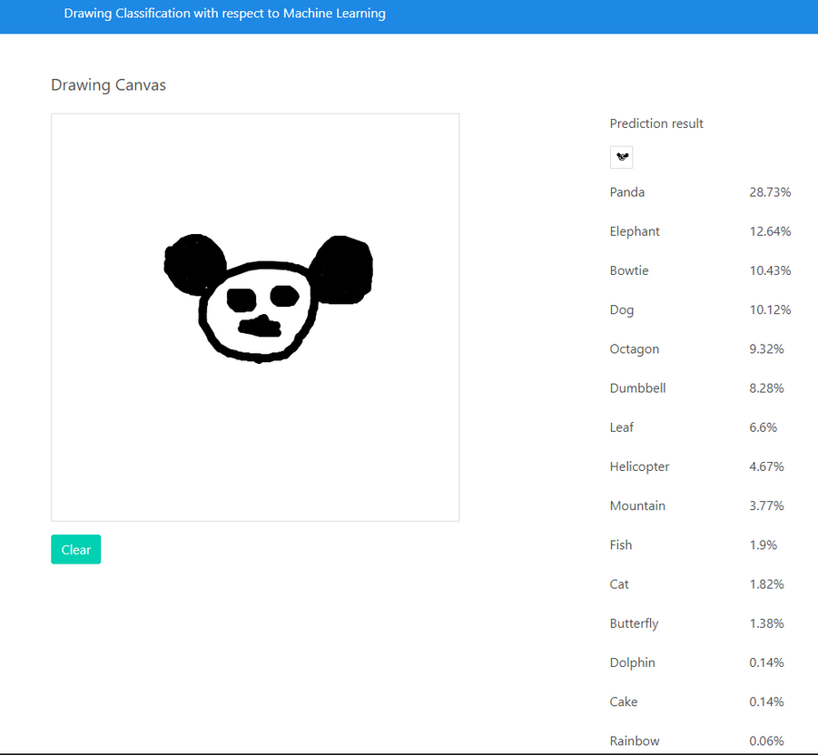
HEROKU APP
https://drawing-ml.herokuapp.com

Slide 16
THANK YOU

